Slide 1
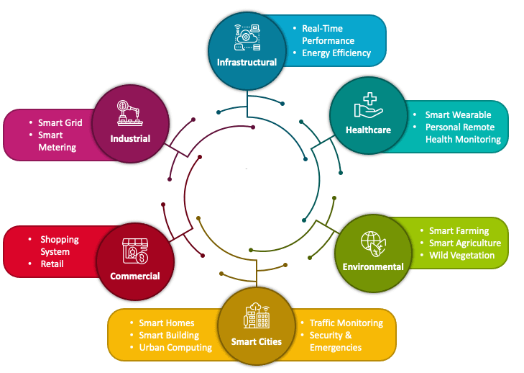

Edge Cloud
Edge_IoT Smart Farming System
PDS
https://github.com/siagianp
https://www.youtube.com/@AmelOline/videos
https://github.com/amelcharolinesgn2/IoT_simulator-mqtt-NodeRed
https://github.com/amelcharolinesgn2/Cloud-Infrastructures
https://github.com/amelcharolinesgn2/ClouD-Infrastructure-SISKA-2025
https://github.com/amelcharolinesgn2/IoT_app-and-Modules
Notes:
https://github.com/Deshan555/IOT-Smart_Farming
https://github.com/Deshan555/IOT-Dashboard
https://github.com/Deshan555/IOT-Dashboard

Slide 2
Smart Farming System Internet of Things
IoT Dashboard Application
IoT Dashboard Application Design
Sensor Box-12
Sensor Box- 2
Automation Box
Dasboard Apps
Notes:
https://github.com/Deshan555/IOT-Smart_Farming?tab=readme-ov-file#iot-smart-farming-system-

Slide 3
IoT Dashboard Application
Visualize your sensor data like never before! This advanced web application is built using HTML, CSS, JavaScript, Bootstrap, and Chart.js to deliver an exceptional user experience. Keep a close eye on vital sensor data such as humidity, heat index, temperature, soil moisture, gas level, and hydroponic solution level.
Feature:
Real-time Visualization: Stay updated with real-time data to monitor changes as they happen.
Multi-chart Magic: Experience the versatility of bar charts, pie charts, and area charts for data representation.
User-friendly Interface: The intuitively designed dashboard offers a seamless user experience.
Responsive Across Devices: Access your dashboard on desktops, tablets, and smartphones with ease.
Empowering Data Analytics: Utilize powerful analytics tools to gain valuable insights from your data.

Slide 4
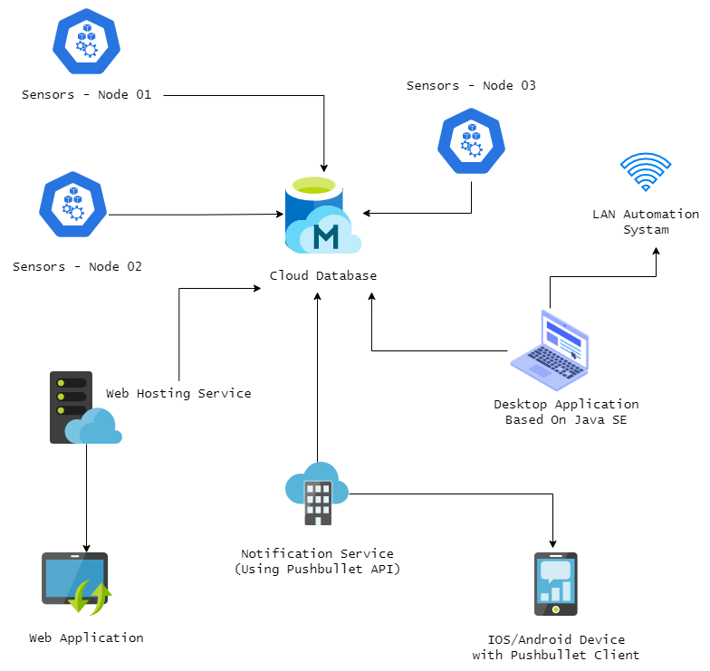
IoT Dashboard Application Design
Sensor Box - 1 📦
Sensor Box - 2 📦
Automation Box 📦

Slide 5
1. Prerequisites :
Web Browser (Chrome, Firefox, or Edge)
Web Server with PHP and MySQL support
MySQL Database
2. Instalation :
a. Clone the repository:
git clone https://github.com/your-username/iot-dashboard.git
cd iot-dashboard
b. Create a MySQL database and import the provided schema:
# Example SQL commands to create the database and import schema
mysql -u username -p
CREATE DATABASE iot_dashboard;
USE iot_dashboard;
SOURCE path/to/schema.sql;
c. Configure the database connection in the PHP files:
// Example: db.php
<?php
$host = 'your_mysql_host';
$username = 'your_mysql_username';
$password = 'your_mysql_password';
$database = 'iot_dashboard';
// ...
4. Set up your web server to point to the cloned project directory.
5. Fire up your web server, and you are ready to go!

Slide 6
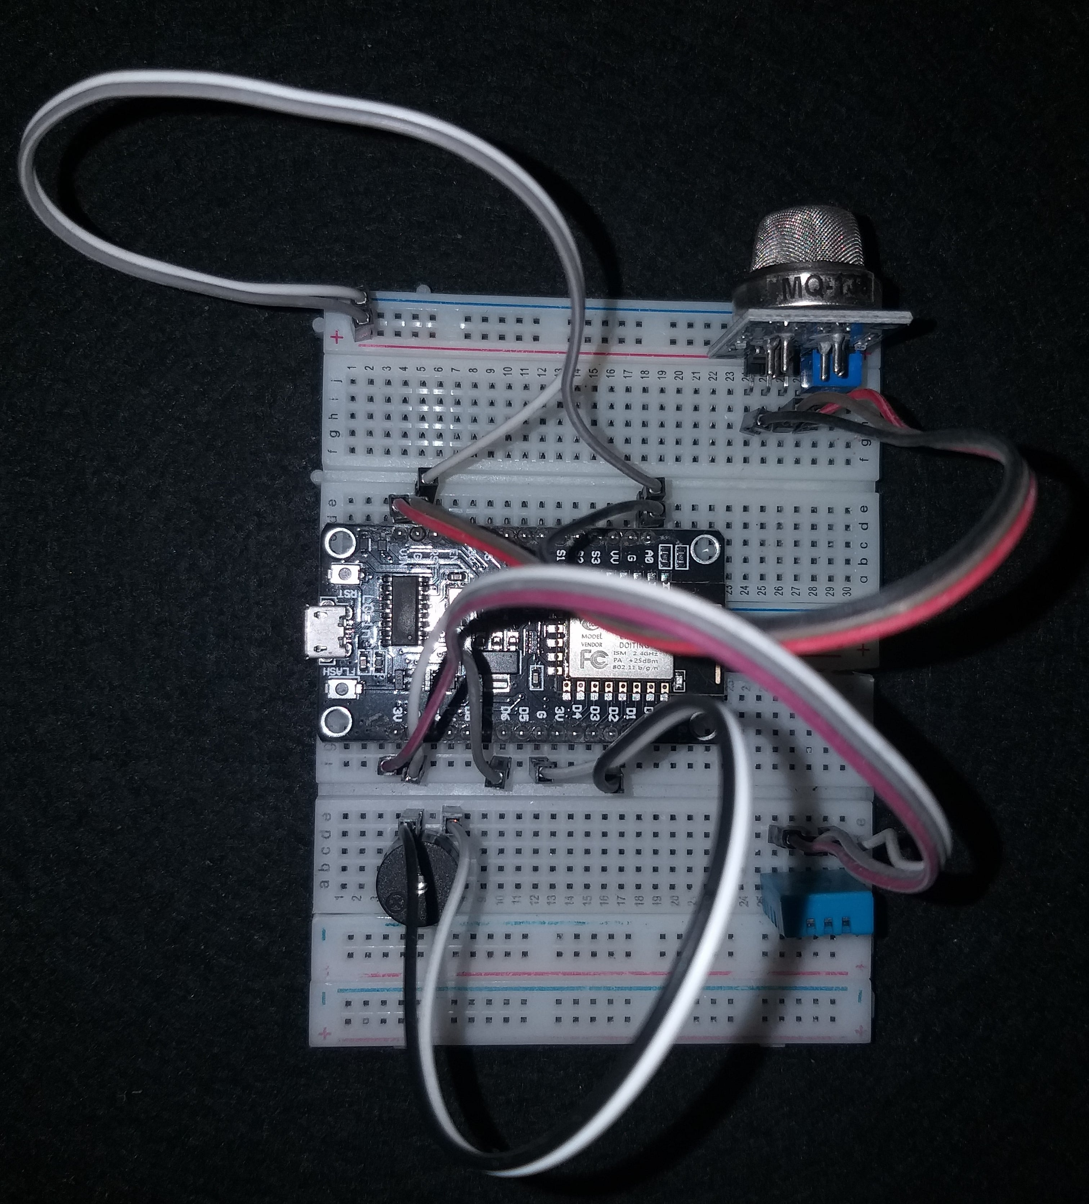
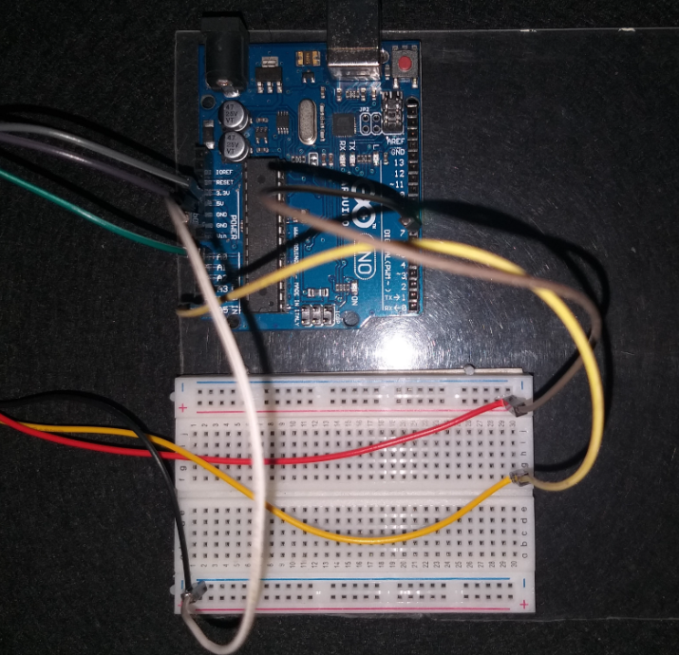
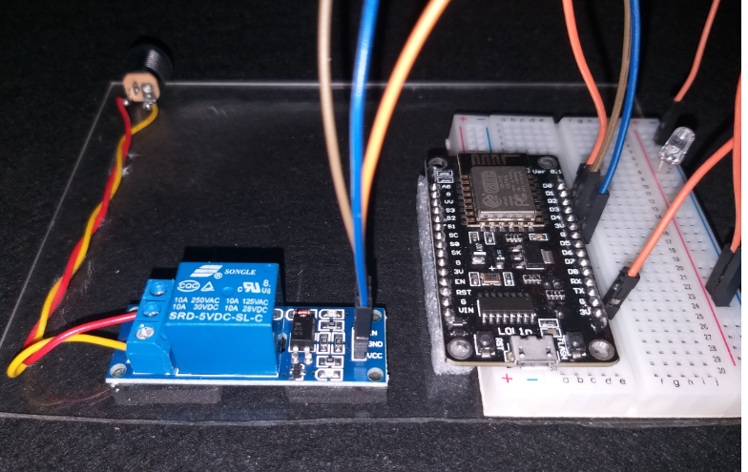
📦Sensor Box - 1 📦
Sensor Box one includes two sensors:
DHT11 or DHT22 for Temperature and Humidity readings.
MQ135 Gas Sensor for Gas Level measurements (P.P.M - Parts Per Million).
Data collected using these sensors includes:
Temperature
Humidity
Heat Index (also known as "feels-like" temperature)
Gas Level (P.P.M)
📦Sensor Box - 2 📦
Sensor Box two includes two sensors:
Water Level Sensor for measuring water level in the hydroponic system.
Soil Moisture Sensor for measuring soil moisture.
Data collected using these sensors includes:
Water Level in hydroponic system
Soil Moisture
📦Automation Box 📦
Sensor box three includes one component:
Low-level trigger and NodeMCU for automation purposes.

Slide 7
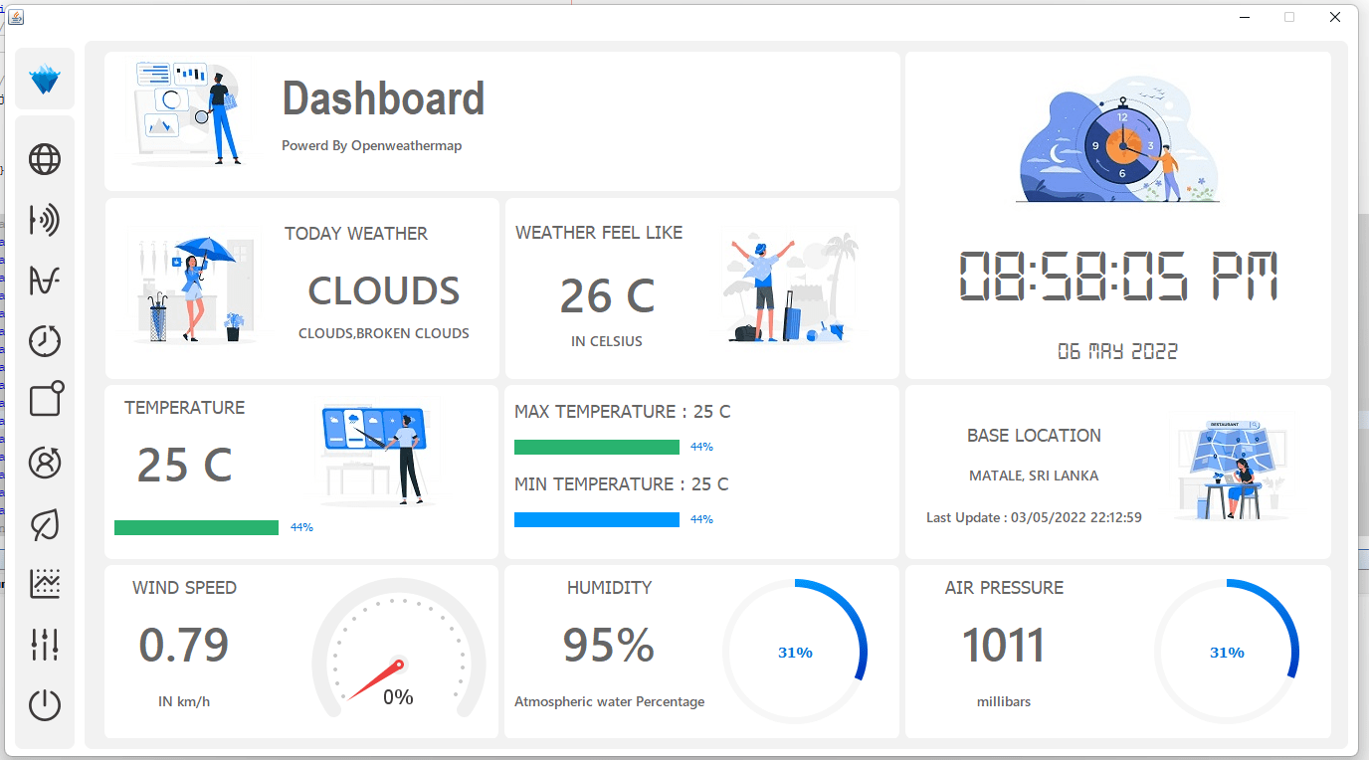
IOT Dashboard Application
Notes:
https://github.com/Deshan555/IOT-Dashboard

Slide 8
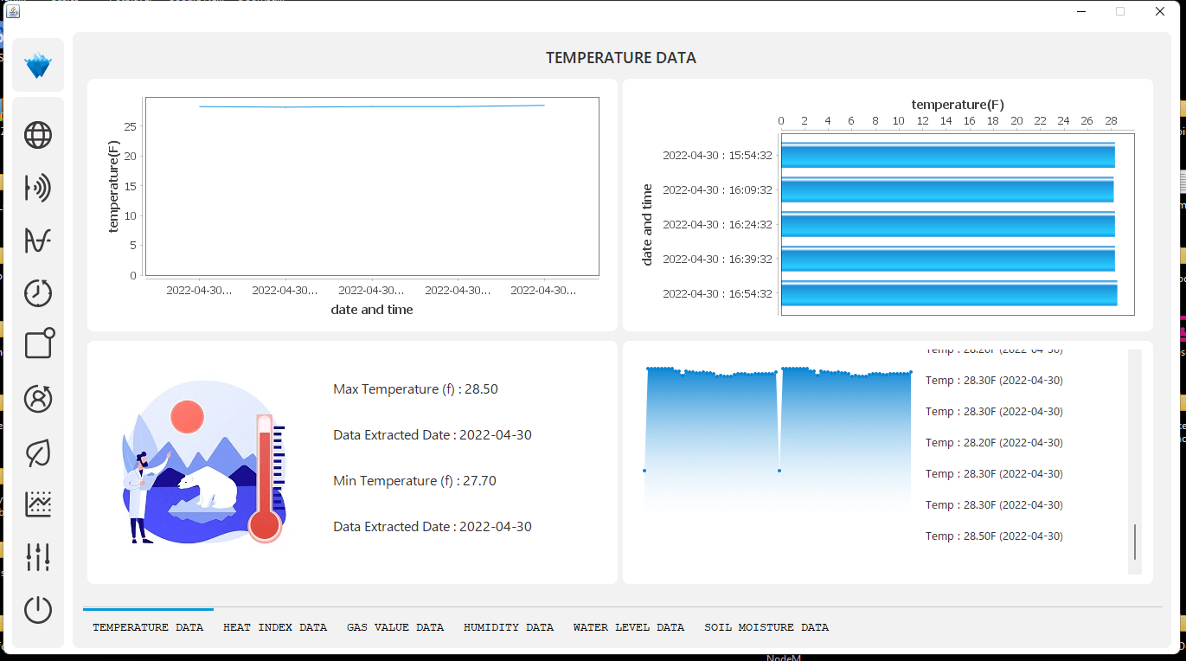

Slide 9
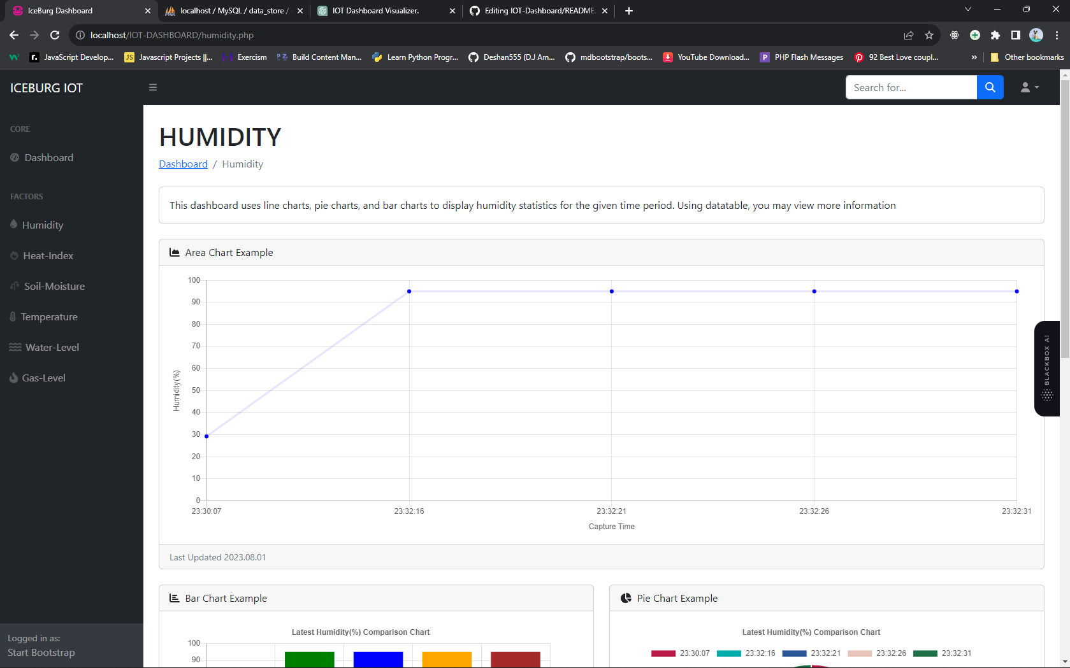
stunning charts and visualizations.

Slide 10
Thank You

